Slide 1

SMART INDIA HACKATHON 2019
NODAL CENTER
Girijananda Chowdhury Institute of Management and Technology, Guwahati
Assam

Slide 2

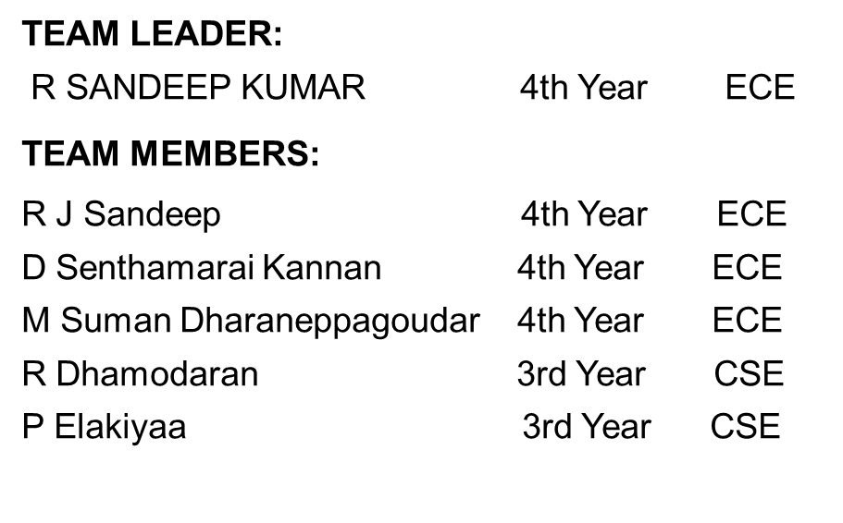
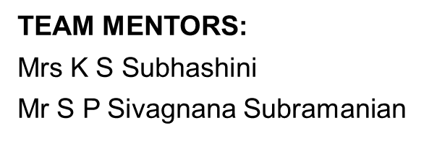
SRI VENKATESWARA COLLEGE OF ENGINEERING Autonomous-Affiliated to Anna University,Pennalur,Sriperumbudur Tk Web Address: www.svce.ac.in
TEAM NAME: THE SAVIOUR

Slide 3
EXISTING APPROACH
PROPOSED SOLUTION
BACK END
FRONT END
DEEP OCEAN ASSESSMENT AND REPORTING OF TSUNAMI (DART)
The real time tsunami buoy system is comprised of two parts:
A bottom pressure recorder (BPR)
Surface buoy with related electronics
The BPR monitors water pressure with a resolution of approximately 1 mm of sea water with 15-second averaged samples. Under normal conditions (no tsunami) the BPR sends data four times in an hour with individual instances being 15 seconds each.
The BPR can make up to 3 attempts to get acknowledgment from the surface buoy that the data has been received.

Slide 4
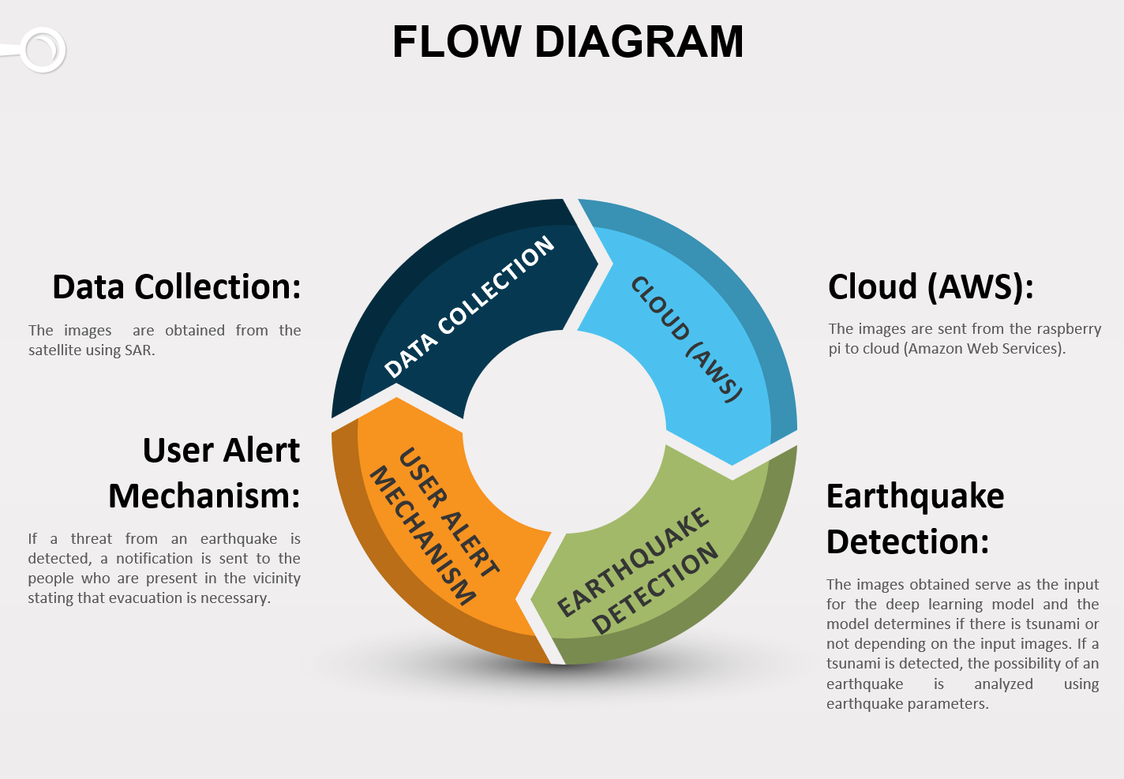

Slide 5
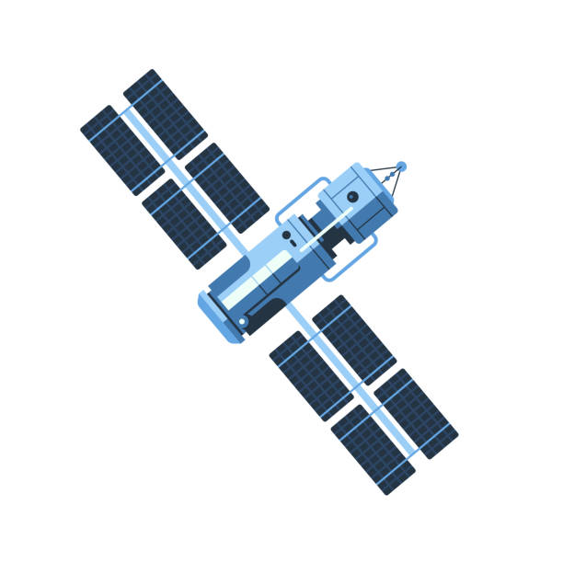


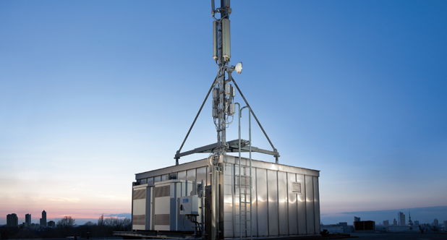



Slide 6
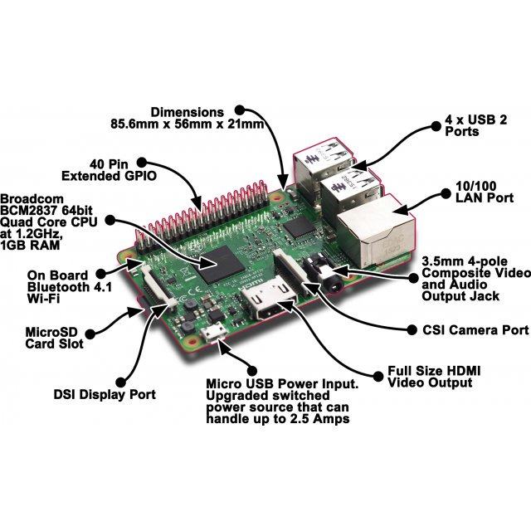
FLOW DIAGRAM
HARDWARE
SNAPSHOTS

Slide 7
CONVOLUTIONAL NEURAL NETWORK
EXISTING APPROACH
PROPOSED SOLUTION
FRONT END
BACK END
Our solution is to build cost effective real time end to end deep learning model using Convolutional Neural Networks (CNN) to detect tsunami from pre-tsunami and post tsunami satellite aerial images.
A dedicated labeled aerial image dataset to construct models that classify whether a building is washed away or not and a particular architecture in CNN is called Inception which works best for satellite aerial images.
Satellite images are passed to our deep learning model in Amazon cloud services (AWS) which will detect if there is a threat from tsunami and alert the coastal guards and police to initiate evacuation.
The model is regularly updated using images that are collected and trained so as to improve the model accuracy in detecting the possibility of a tsunami.

Slide 8
EXISTING APPROACH
PROPOSED SOLUTION
FRONT END
BACK END
TECHNOLOGY STACK
The front end pertains to a webpage which incorporates a log in mechanism after which the user would be able to choose among the cities given (Chennai, Calcutta, Mumbai and Trivandrum). This operation is necessary for user efficient user interface.
The database is obtained from Amazon Web Services(AWS). The images are stored in S3 bucket.
Website design is implemented using JavaScript, Bootstrap and HTML. The front end is hosted using Flask library which is used to host webpages.

Slide 9

EXISTING APPROACHES
PROPOSED SOLUTION
FRONT END
BACK END
The back end aspect of our project is accomplished using the mechanism of Convolutional Neural Networks(CNN).

Slide 10
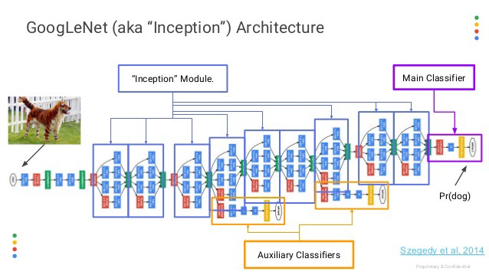
SOFTWARE ARCHITECTURE
DIFFERENT ASPECTS OF PROJECT
INCEPTION MODEL:

Slide 11
ALERT MECHANISMS
4 different alert mechanisms :
SMS with link to map notification
E-MAIL
SIREN
WEBPAGE

Slide 12
SOFTWARE ARCHITECTURE
DIFFERENT ASPECTS OF FUTURE
SCOPE FOR IMPROVEMENT:
Availability of the application in many regional languages.
Incorporation of more secure and accurate models.
Incorporation of a provision wherein the evacuation is carried out by means of automated Transportation.
Provision for End User Interface.
NOVELTY IN OUR PROPOSED WORK:
Cost Effective
Time Efficient
Scalable
VIABILITY OF THE PROPOSED MODEL INTO A BUSINESS PRODUCT:
A mobile application can be created.

